Slide 1
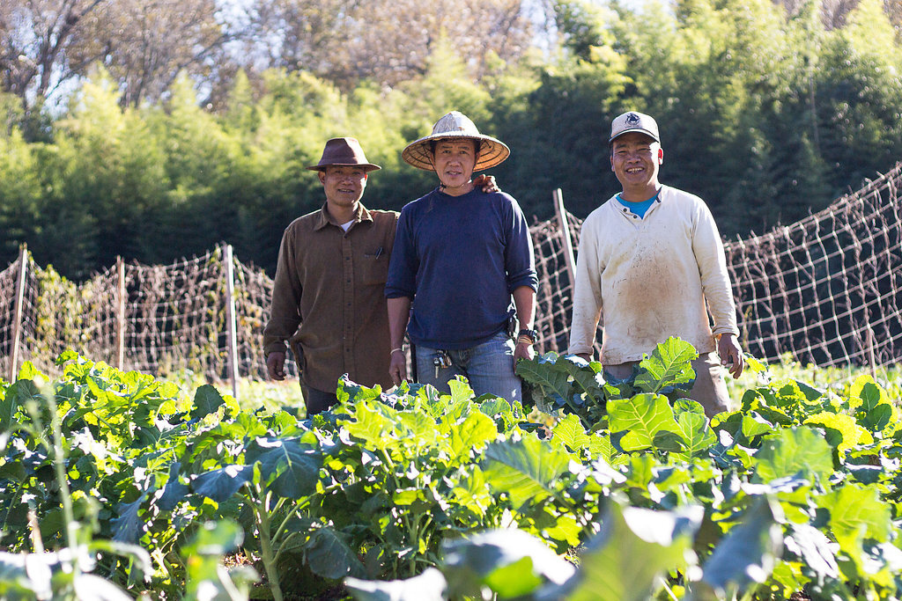

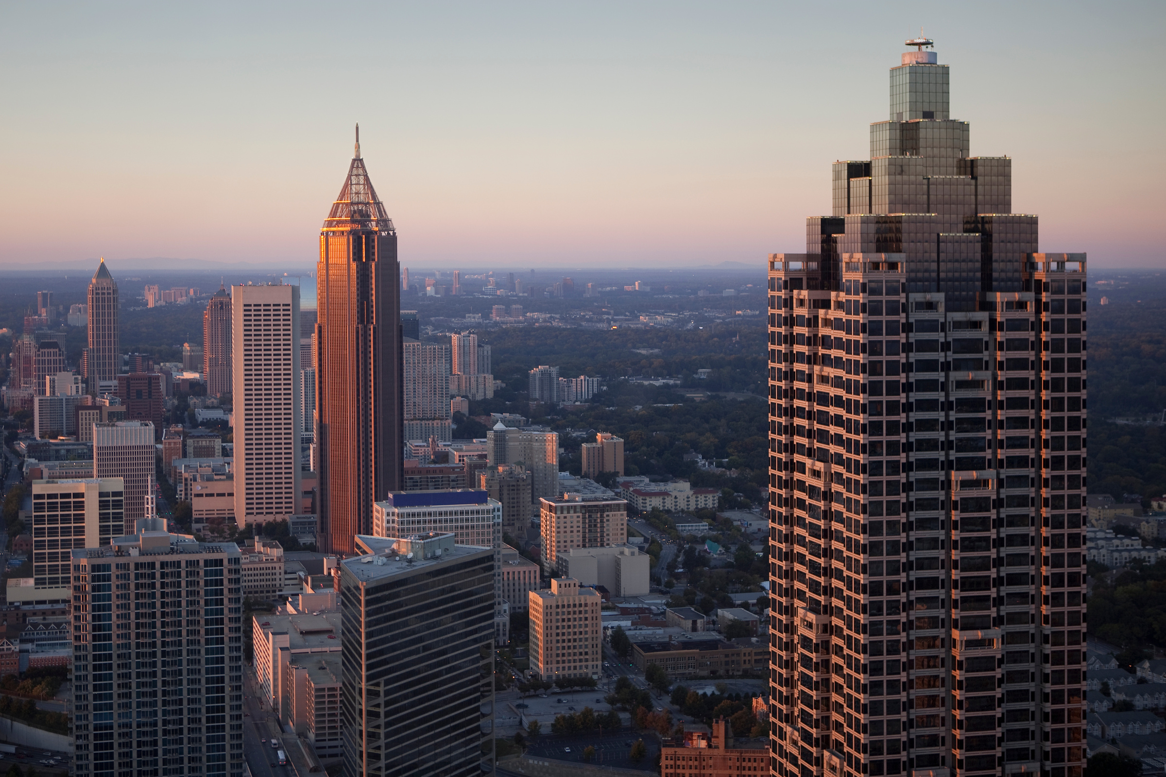


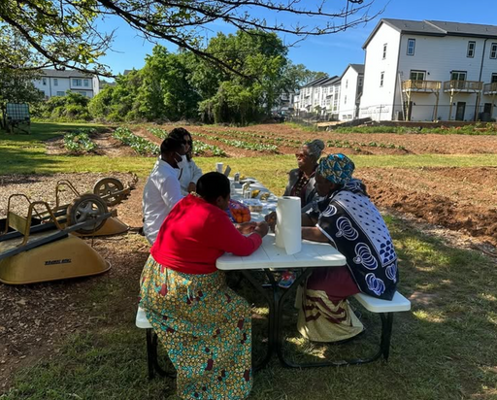
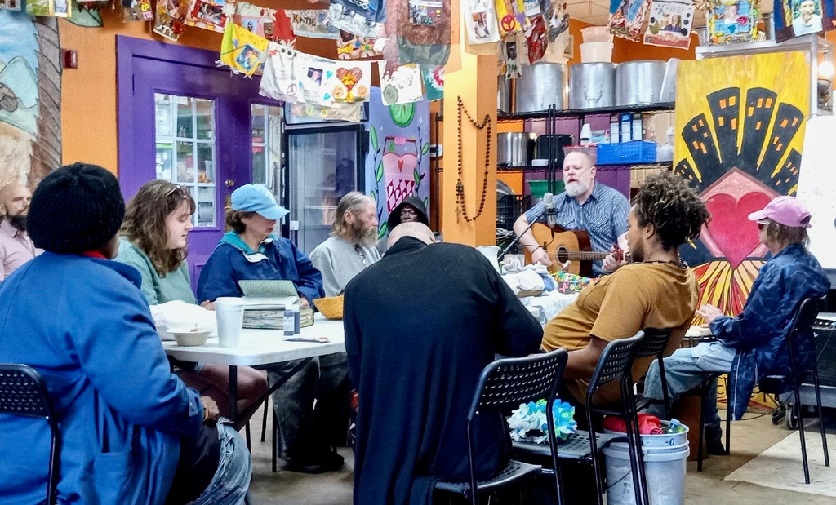

2025
SENIOR HIGH
MISSION
TRIP
Destination:
Atlanta, GA

Slide 2
Focus: Homelessness and Refugee Integration
This summer we are going to Atlanta, GA to partner with local organizations for service, learning, and relationship-building opportunities around issues of homelessness and refugee integration. By diving into the intersections of poverty, systemic racism, immigration, and faith, we will deepen our understanding of how we can affect positive change in our own community and around the world.

Slide 3

MISSION PARTNER
Love Beyond Walls
LBW exists to change the narrative on homelessness through education and storytelling, with the hope of building empathy and inspiring people to serve and be proximate to their neighbors without an address. With their work, they are striving to create a safe space that allows those who are unhoused or facing poverty to have a voice, visibility, and essential resources for day-to-day living.

Slide 4



POTENTIAL MISSION PARTNERS

Slide 5
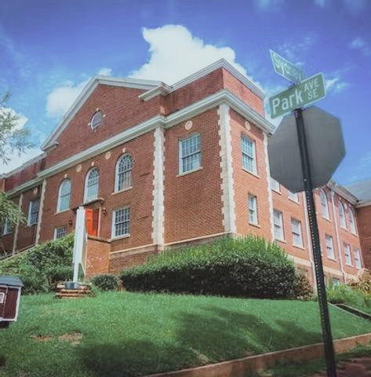

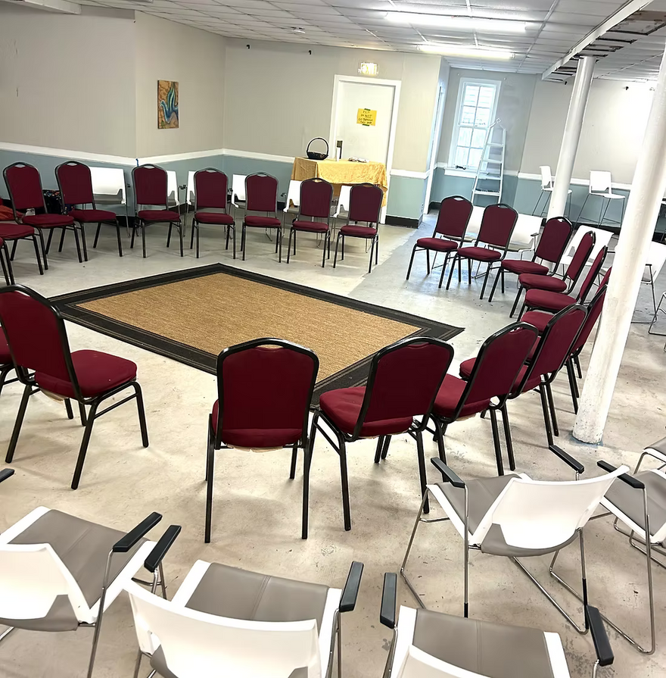
ACCOMMODATIONS
Park Avenue Baptist Church
A place for: Re-Creation, Resiliency & Restoration
As our “Home Base” in the Atlanta area, PABC will support us by providing accommodations and facilities for us to sleep, eat, gather, play, and worship.

Slide 6
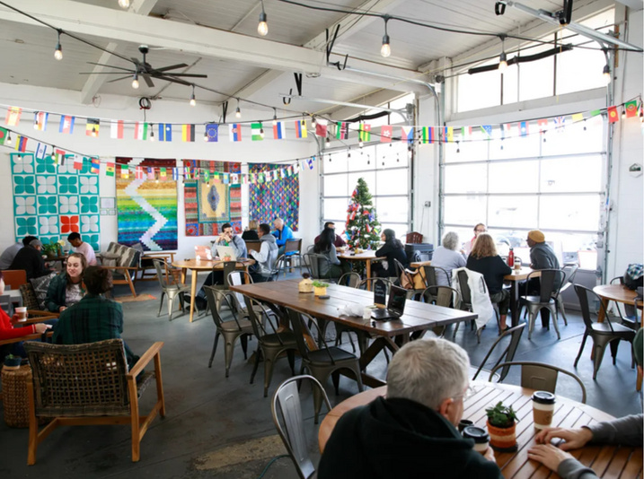
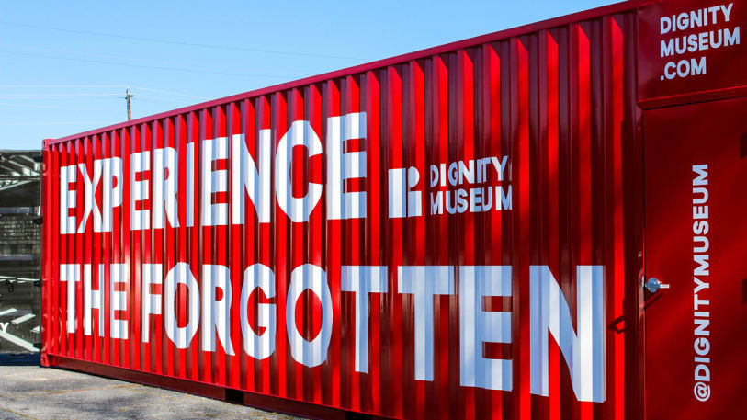
LEARNING OPPORTUNITIES
Atlanta Justice Tour
The Dignity Museum
Using public transportation, our group will go on a tour of the city and learn about its history of housing discrimination and mistreatment of unhoused people, as well as the ways gentrification and legislation affect people in poverty today.
The Dignity Museum shares the stories of the forgotten, while presenting the unjust causes for the disparity in resource allocation. The stories of those who were born into poverty, those who became homeless as adults, the kids holding cardboard signs at the stoplight, and their collective fight to beat their circumstances.

Slide 7
SPIRITUAL ENGAGEMENT
Daily Group Devotional Time
But seek the welfare of the city where I have sent you into exile, and pray to the Lord on its behalf, for in its welfare you will find your welfare.
Prayer Stations that Connect our Faith to our Work
Small Group Time
No phones or internet
Jeremiah 29:7

Slide 8
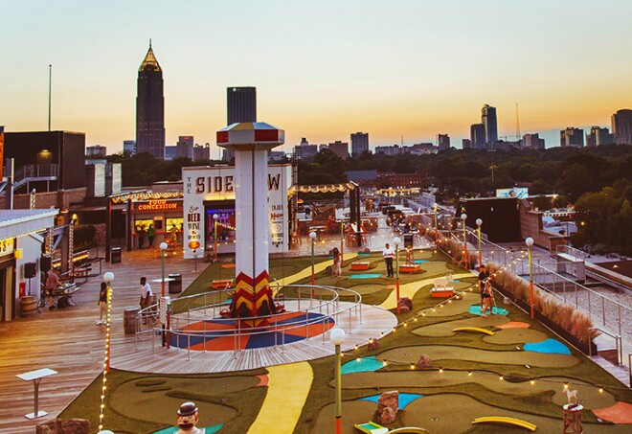
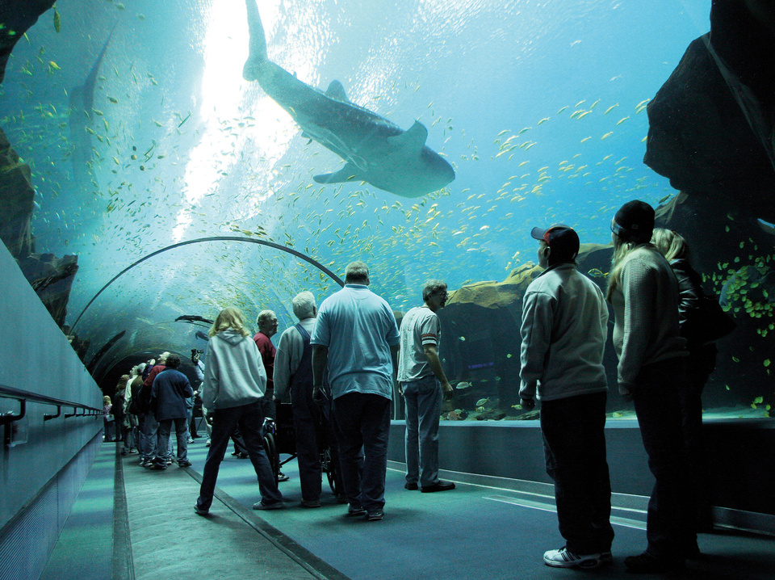
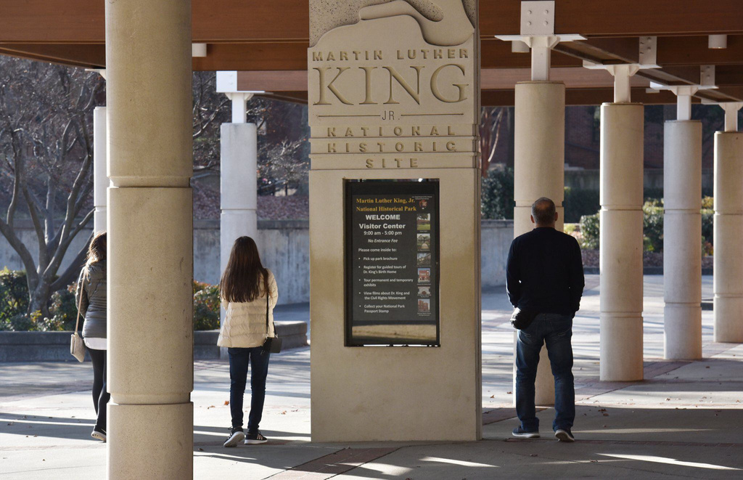
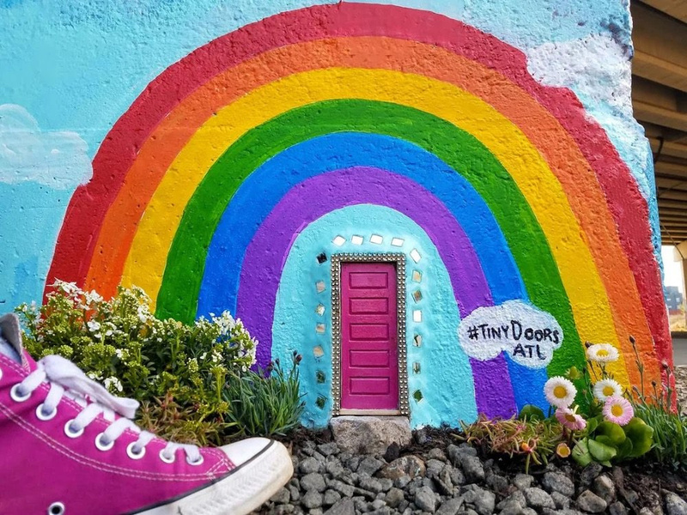
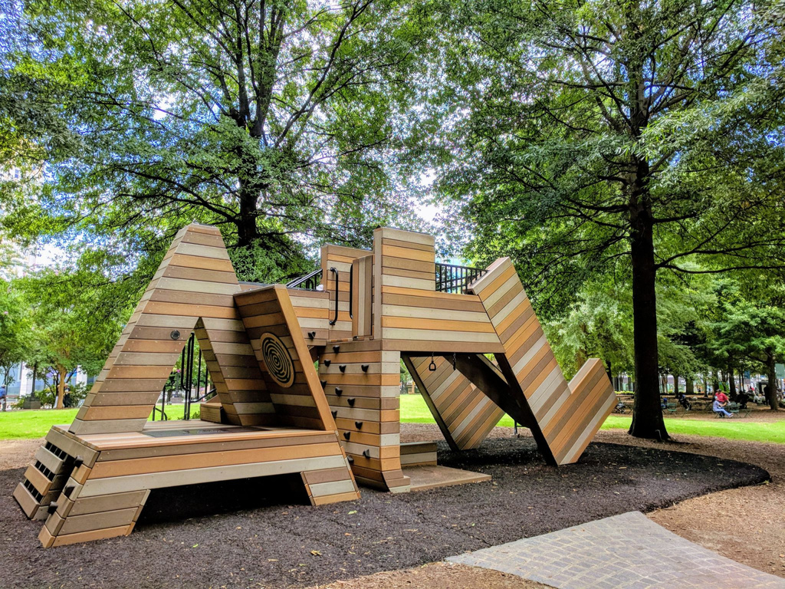
POTENTIAL SOCIAL & CULTURAL EXPERIENCES
Woodruff Park
Tiny Doors ATL Scavenger Hunt
Georgia Aquarium
MLK Jr. History Tour
Skyline Park @ Ponce City Market
Woodruff Park is one of downtown Atlanta’s greatest green spaces to soak up the city. Visit the International Peace Fountain, take in the public art and sculptures, and borrow free board games, lawn games, and sporting equipment from the Game Cart.
This public art project currently has over 30 installations in Atlanta which attract thousands of locals and
tourists alike to their respective neighborhoods. Each door is different - how many can you find?
This aquarium, the largest in the US, exhibits thousands of animals across its seven major galleries. The aquarium's notable specimens include whale sharks, beluga whales, California sea lions, bottlenose dolphins, manta rays, sea otters, and tiger sharks.
Get an in-depth look at the people and locations that inspired MLK, Jr., while literally walking in the footsteps of Civil Rights leaders like Dr. King, Congressman John Lewis, Coretta Scott King and many others.
With a Coney Island style boardwalk that includes mini golf, horse derby race, basketball, skee-ball, and goblet toss, this rooftop park also boasts some of the best views in ATL. Don’t forget to ride the 3-story slide!

Slide 9
Leaders
Kent Bromley
Elaine Johnson
Elizabeth McVey
Steve Perkins
Hailey Braden Lynch
Associate Pastor

Slide 10
Mission Trip Dates Deadlines
March 2: Registration deadline
May 18: Mandatory meeting
June 8: all forms and final payments due
July 13: Commissioning Sunday
July 18-25: Senior High Mission Trip in ATLANTA, GA
July 27: Youth Sunday

Slide 11
Fundraisers
All trip participants must come to at least one of the following Sundays, 9-11am
March Mission Trip Madness
Donut Days
Stock Sale
March 2, 9, or April 6
May 11 or 18
Date TBD
All participants must volunteer

Slide 12
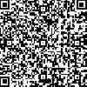
REGISTER TODAY
$750 scholarships available

